Slide 1
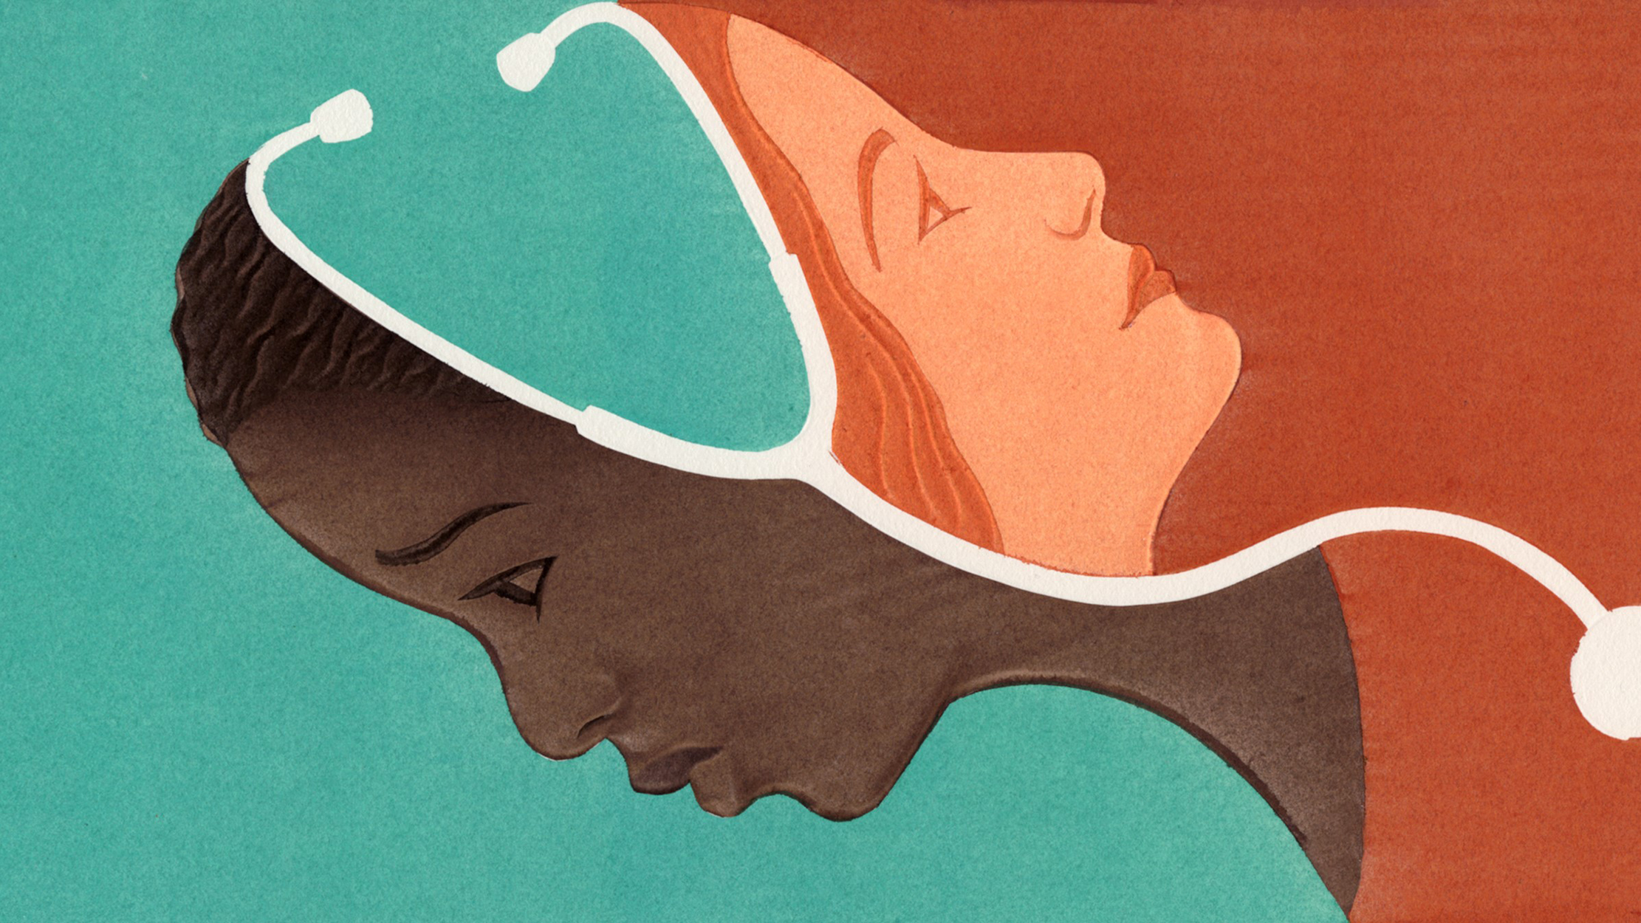
Racism and Medicine
Vimal Vinod

Slide 2

My goals
This presentation might make some of you uncomfortable
I want to present to you examples to back up my claim that medicine in the US was built on racist ideologies that targeted minorities, specifically African Americans and then how to move past that
I hope that this presentation helps you understand why medicine needs to become more diverse and inclusive

Slide 3
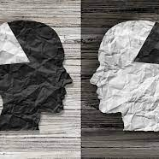
Background
America’s health system from its very founding has been rooted in racism
Racism is…
“beliefs, attitudes, institutional arrangements and acts that tend to denigrate individuals or groups because of phenotypic characteristics or ethnic group affiliation.” (Clark et al., 1999)
Manifested through stereotypes, prejudices, and/or discrimination

Slide 4
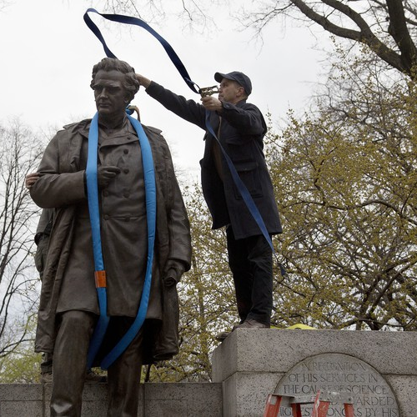
J. Marion Sims
J. Marion Sims – The first physician in America to receive a statue honoring his contributions to medicine
President of AMA
Considered by many to be the “founder of modern gynecology”
The treatments he came up with were based on experiments he conducted on black slaves
He carried out these experiments w/o anesthesia
Every field of medicine has a horror story like this
https://www.youtube.com/watch?v=IfYRzxeMdGs&ab_channel=Vox

Slide 5
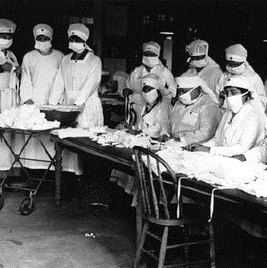
The flu Epidemic of 1918
Infected 675,000 people in the USA, with a total of 500 million worldwide
Black communities were refused care by many hospitals
Many had no money to pay for any of the medicine/treatment even if they could receive treatment
The African American community had to treat their own because the wider medical community would do nothing
Parallels to COVID19 today

Slide 6
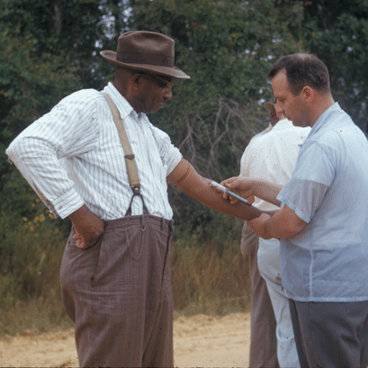
Tuskegee Syphilis Study
Involved with 600 black men, 399 with syphilis and 201 with no disease.
Researchers explained to the men they were being treated for "bad blood”
The men were told by researchers and health professionals that they would be participating in a study to cure their current illnesses.
As a result, by July 1972 when the study ended, over 100 participants had died, 40 spouses had been diagnosed, and disease had been passed to 19 children at birth
Has led to hesitancy in the African American community on participating in research studies
https://www.youtube.com/watch?v=fxeLohZEqs0&ab_channel=TodayIFoundOut

Slide 7
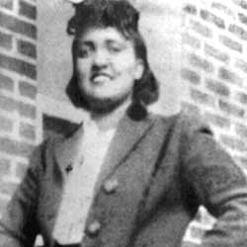
Henrietta Lacks
An African American woman whose cancer cells are the source of the HeLa cell line
HeLa cells reproduce indefinitely under specific conditions
She was a 31-year-old mother of five whose cells were taken and used without her consent or knowledge
Lacks's relatives received no financial benefit and continued to live with limited access to healthcare

Slide 8
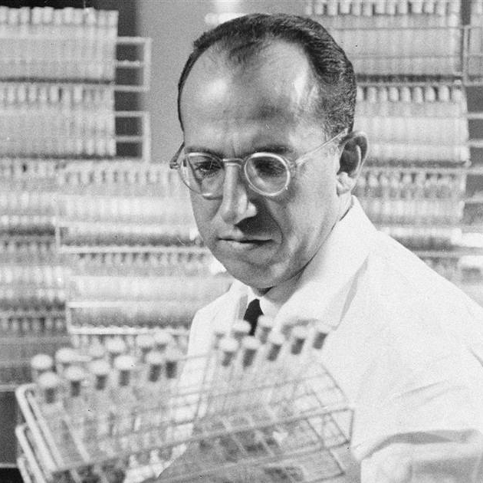
Hela Cells in Medicine
Used by Jonas Salk when creating the Polio vaccine
Used in the development of the HPV vaccines
Used in figuring out the number of chromosomes a human cell contains – Important for Down syndrome research
Used to research the effects that being in outer space has on human cells

Slide 9
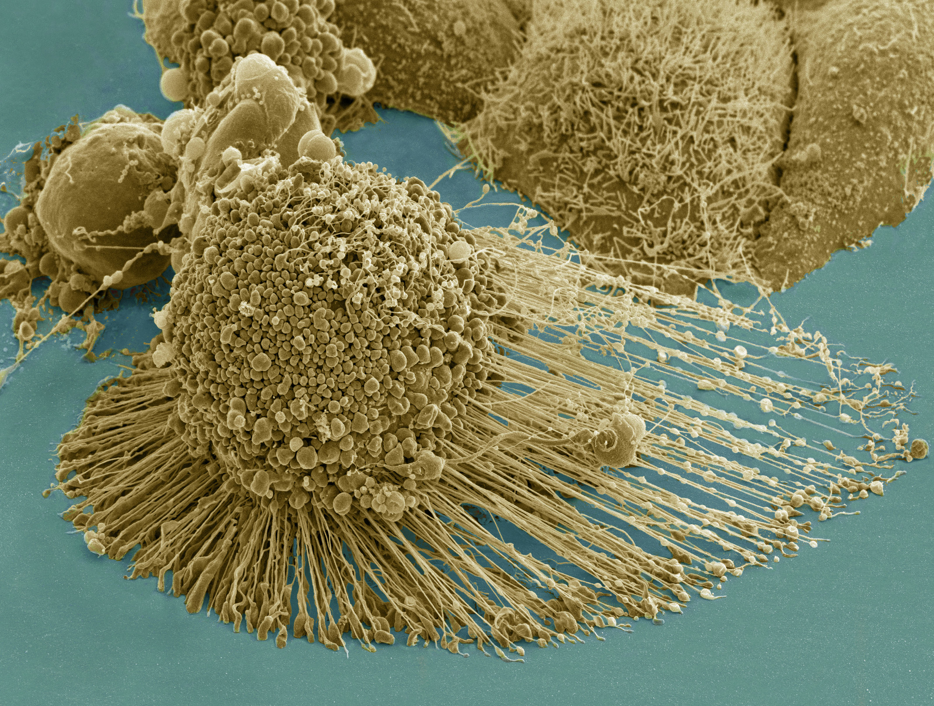
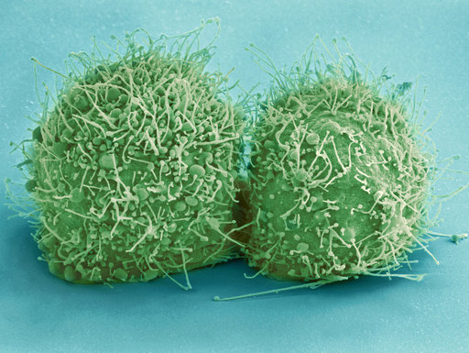
Hela Cells

Slide 10
These Issues Still Persist Today

Slide 11
Modern Examples – Maternal Health
African American women are three to four times more likely to die in childbirth than white women
African American babies are twice as likely to die than white babies
Racism found in the delivery of health care and social service means black women often receive substandard care in comparison to white women
African American women face greater chances than white women to have chronic stress which can stem from living in impoverished neighborhoods or encountering discrimination.

Slide 12
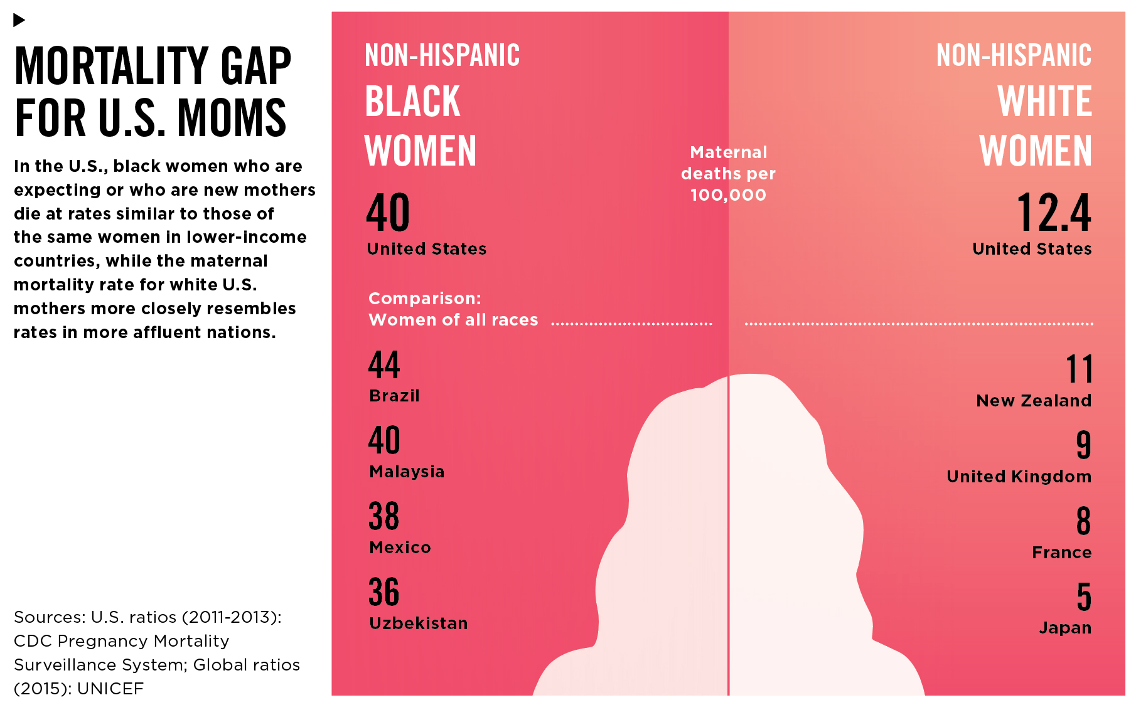
Modern Examples – Maternal Health

Slide 13
Modern Examples – Cardiovascular Health
According to the U.S. Department of Health and Human Services Office of Minority Health, in 2018, African Americans were 30% more likely to die from heart disease than non-Hispanic whites.
Stereotypical assumptions may lead to lower-quality care for minority patients and in this case, it can lead to deaths and disease rates that are far higher than those of their white counterparts

Slide 14
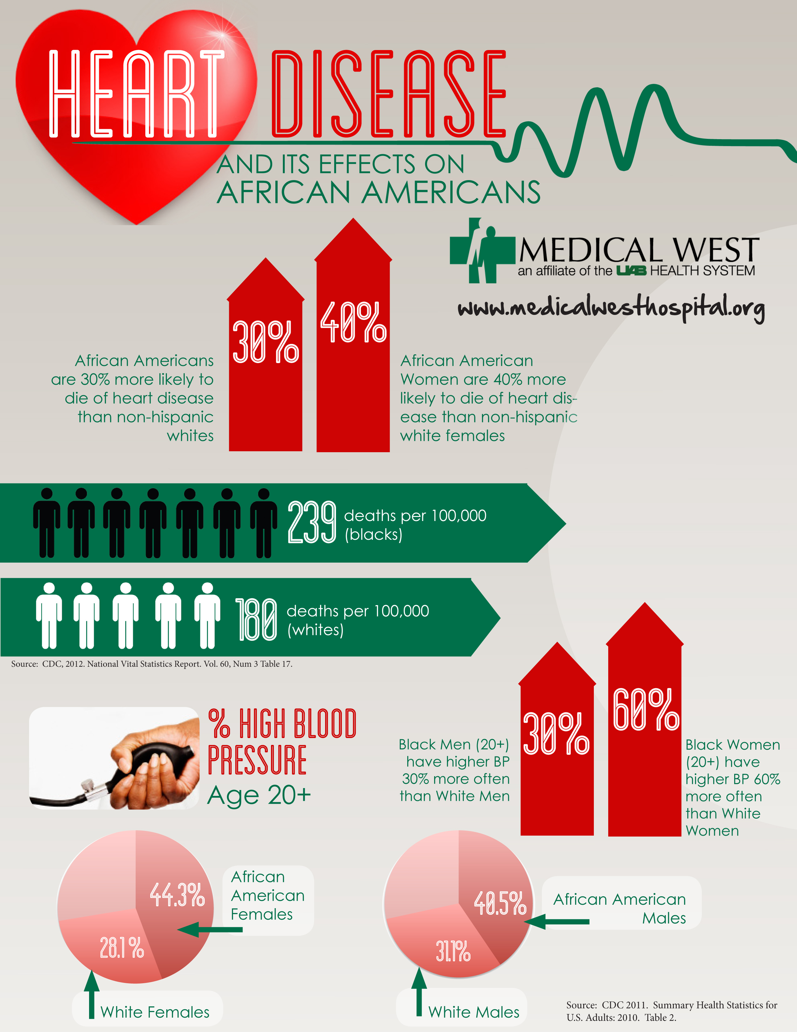
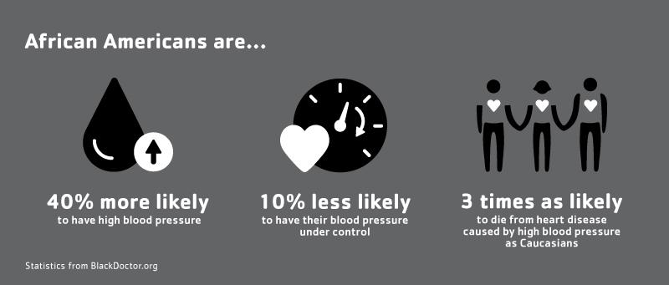
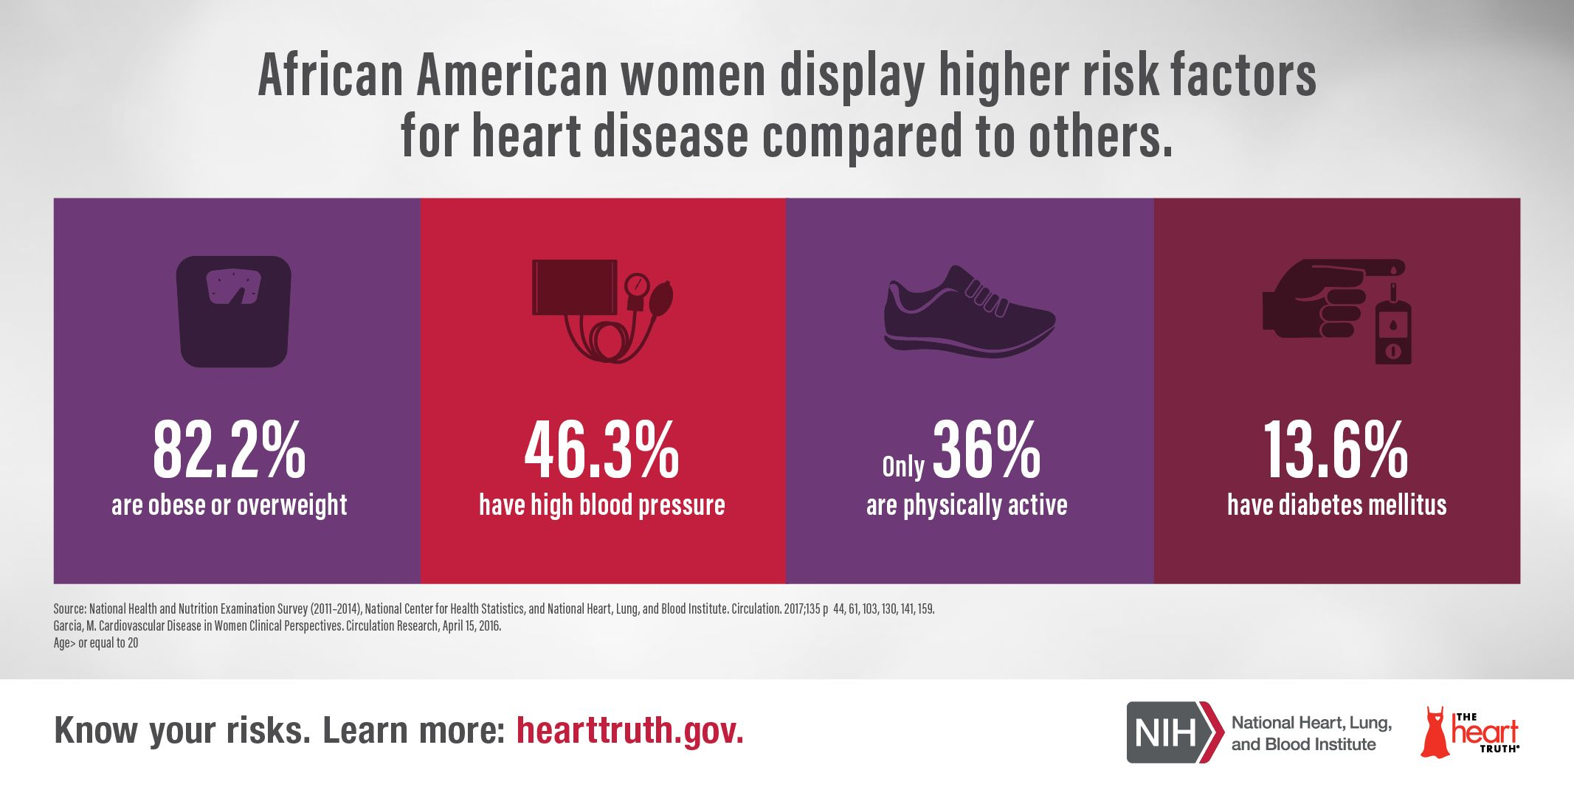
Modern Examples – Cardiovascular Health Cont.

Slide 15
Environmental Racism
Environmental racism refers to the many ways that communities of color—in the United States, Black communities in particular—face greater harms from environmental factors.
Hospitals are less likely to be in these poorer communities that African Americans predominantly live in
This means that access to care is more difficult to get to and more spread out than in white communities where hospitals are often far closer

Slide 16
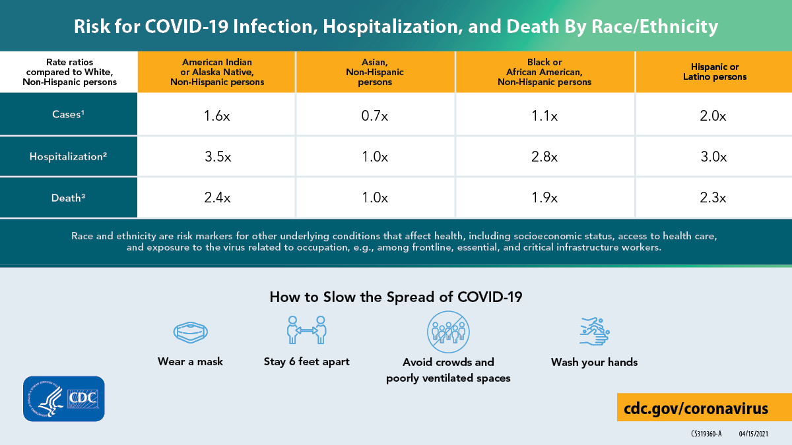
COVid-19
https://www.youtube.com/watch?v=XAFD-0aMkwE&ab_channel=Vox

Slide 17
Why all of this is important
All of this is important because we need to acknowledge that racism has been a fundamental part of the medical field in the USA
We can fix this in the medical education by encouraging and putting together the resources needed to help African American youth pursue medicine as a career
By doing this, we help African Americans by allowing them to affect change from within a medical community that has for the longest time excluded and discriminated against them

Slide 18

Questions?

